Slide 1
WP2 & WP2: Enabling our facilities to produce FAIR data
Andy Gotz, Brian Matthews,
UKRI-STFC

Slide 2
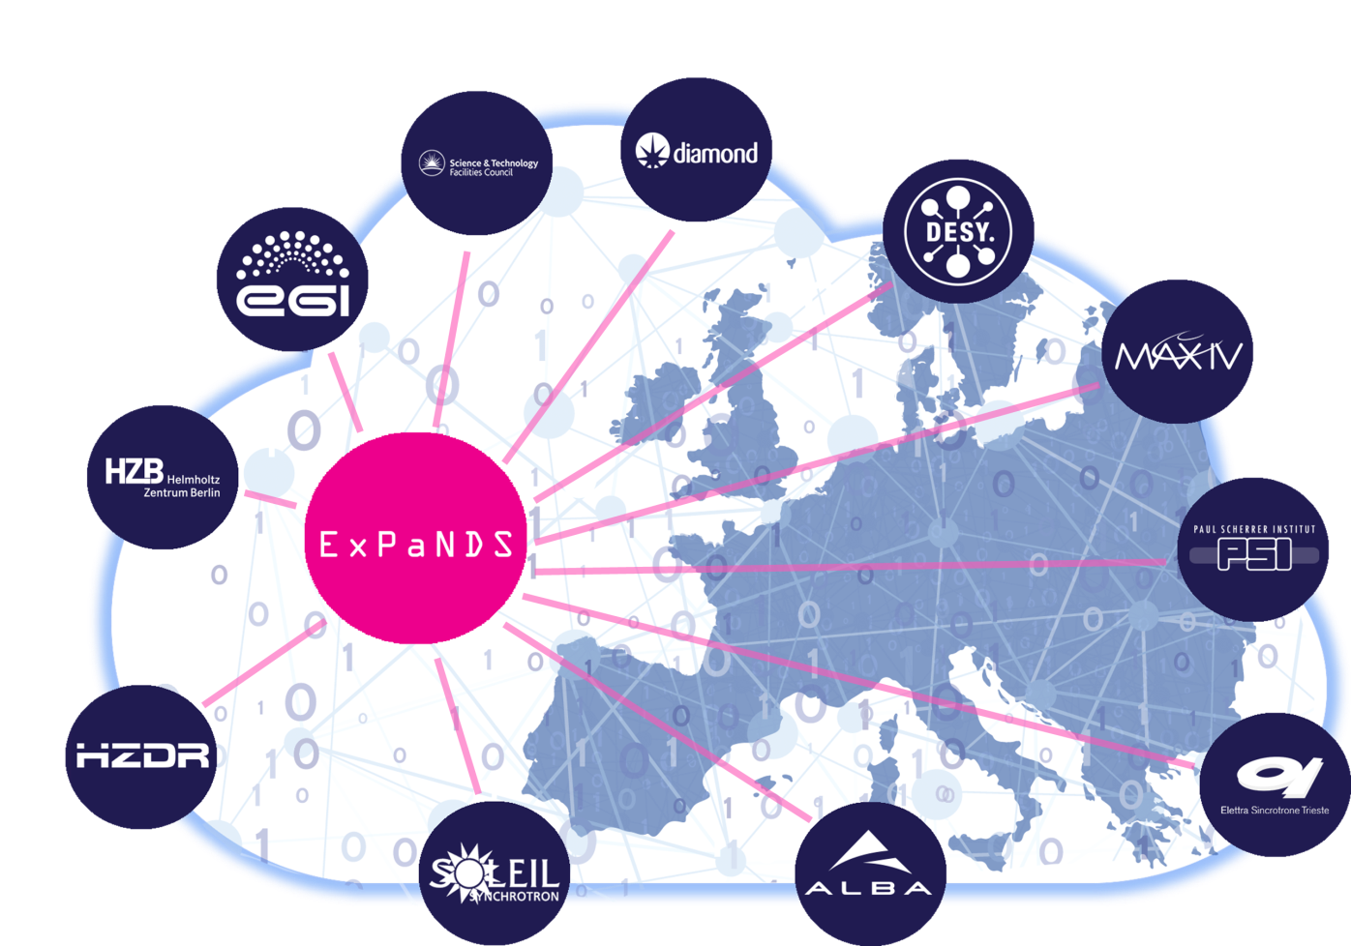

ExPaNDS WP2: Enabling FAIR data PaNOSC WP2: Data Policy and Stewardship
Review and recommend the policies, practises, standards and tools which would develop best practise for FAIR data generation and use in the National Photon and Neutron RIs.
In the policies of the RIs
In the data-generation, collection and analysis process
In Data Management Planning
Raising awareness and competence in FAIR data of our scientific communities.
To guide services to support FAIRness

Slide 3
Steps towards FAIR Facilities
FAIR Policy
FAIR Guidelines
FAIR Tools
FAIR Experiments
Commitment to FAIR
Support from Facility
Ownership
Expectation on users
How FAIR can be supported along the data lifecycle
Use of PIDS
Metadata standards
Implementation strategies
FAIR Metrics
Providing tools that support FAIR
Data storage
Data cataloguing and publishing
Data Analysis
Integrated VREs
ELNs
Support to conduct FAIR experiments
Planning for FAIR – DMPs
Facility staff and users
Embedding in processes

Slide 4
ExPaNDS WP2: Work Tasks
2.1 Alignment policies & practices:
Reviewing and revising data policies for FAIR data in the EOSC
Aligning with similar work in PaNOSC
2.2 Data management planning:
Considering how FAIR data can be collected during the facilities research lifecycle
Using Data Management Planning to capture metadata and allow the creation of FAIR data for an experiment
Active DMP as a mechanism for enabling and automating FAIR data creation and use in the lifecycle
2.3 Mainstreaming of standards:
Consider how each of the 13 FAIR principles apply to Facilities Science
Review how they are currently being applied
Recommend best practises and standards so that they can be satisfied
Promote standards across the facilities.
2.4 Persistent identifier infrastructure:
Best practises for assigning and linking PIDs into a “PID Graph”
Investigate emerging PIDs – e.g. Organisations, Instruments
2.5 QA & certification schemes:
Consider emerging FAIR Data Maturity models and how they might apply to P&N RIs
Self-assessment of ExPaNDS RIs
2.6 Uptake of FAIR data practices:
Advocacy and awareness of FAIR data practise to ExPaNDS stakeholders
Senior management, Instrument Scientists, User Researchers
Competencies of Data Stewardship

Slide 5
Steps towards FAIR Facilities
D2.6
FAIR Policy
FAIR Guidelines
FAIR Tools
FAIR Experiments
Commitment to FAIR
Support from Facility
Ownership
Expectation on users
How FAIR can be supported along the data lifecycle
Use of PIDS
Metadata standards
Implementation strategies
FAIR Metrics
Providing tools that support FAIR
Data storage
Data cataloguing and publishing
Data Analysis
Integrated VREs
ELNs
Support to conduct FAIR experiments
Planning for FAIR – DMPs
Facility staff and users
Embedding in processes
T2.1
T2.3, T2.4, T2.5
WP3
WP3 WP4
T2.2

Slide 6
ExPaNDS WP2: Deliverables
Deliverable |  | Month | Task | Status
D2.1 | Draft extended data policy framework for Photon and Neutron RIs | 12 | T2.1 | Done
D2.2 | Draft recommendations for FAIR Photon and Neutron Data Management | 15 | T2.3 | In Progress
D2.3 | Final data policy framework for Photon and Neutron RIs | 24 | T2.1 | Next
D2.4 | DMPs for Photon and Neutron RIs | 27 | T2.2 | Started working with PaNOSC
D2.5 | Advanced infrastructure for PIDs in Photon and Neutron RIs | 30 | T2.4 | About to start
D2.6 | Self-evaluation of Photon and Neutron RIs for FAIR data certification | 39 | T2.5 | Not started
D2.7 | Final Recommendations for FAIR Photon and Neutron Data Management | 36 | T2.3 | Not started
D2.8 | Active DMPs for Photon and Neutron RIs | 39 | T2.2 | Not started
D2.9 | Report on promotion of FAIR data within Photon and Neutron RIs | 42 | T2.6 | Started – need input

Slide 7
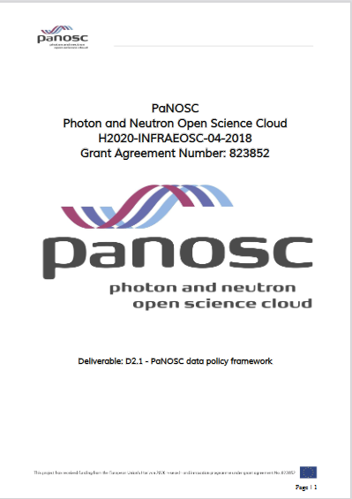
D2.1: Towards FAIR policies for Photon and Neutron RIs
ExPaNDS and PaNOSC have been working together to revise data policies frameworks in the light of the FAIR data principles
PaNOSC D2.1: PaNOSC data policy framework
A model policy for adaptation and adoption by PaNOSC Partners
May 2020: https://doi.org/10.5281/zenodo.3826039
ExPaNDS D2.1: Draft Extended Data Policy Framework for
Photon and Neutron RIs
18th September 2020: https://doi.org/10.5281/zenodo.4014810
Guidance on adopting a FAIR data policy for national RIs
Taking into account FAIRsFAIR’s recommendations on Data Policy
Key Policy Elements within a PaN RI Data Policy Framework
30 data policy framework elements
Aim to have a common approach to data policy across
all P&N RIs
Value in a compatible approach in different facilities
Easier for users to move around, easier to combine data
105 views
82 downloads

Slide 8
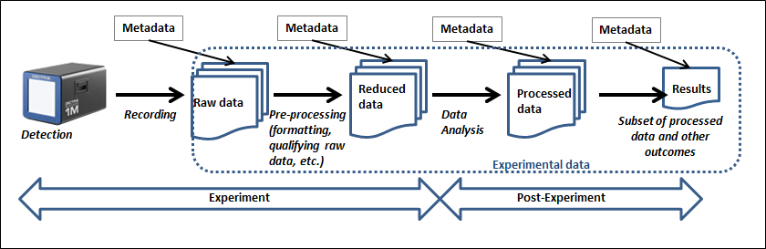
Adding FAIR to Policy
“RIs’ data policies should enable the experimental data in scope to be FAIR”
This gives an implicit commitment to uphold the FAIR principles.
Leads to other policy principles
RIs should specify the grounds for restricting access to data (A1.2)
In the event that data are deleted, the facility should retain a “digital footprint” of the data (A2)
The RI’s data policy should specify a licence under which the data are made available (R1.1)
The RI’s data policy should include commitments to enabling FAIR data which include [PIDs and Collecting sufficient Metadata]
And also requirements for implementations conforming to policy
Simplified illustration of Classes of Experimental Data in the Science Life Cycle (from the Soleil Data Policy)
“Data should be FAIR when it leaves the Facility”
Can be assessed via FAIR Metrics

Slide 9
T2.1: Policy Next Steps
Consult on recommendations with ExPands Facilities
Revise and extend guidelines
Convergence with PaNOSC Model policy
Final Policy recommendations: August 2021

Slide 10
D2.2: Draft recommendations for FAIR Photon and Neutron Data Management
In advanced draft
Lead by Daniel Salvat
A detailed analysis of the steps of Experimental process and what is needed for FAIR-ness at each stage
Towards recommendations for Metadata

Slide 11
FAIR Guidelines: FAIR at every step
PaN-data Open Data Infrastructure. Model of the data continuum in Photon and Neutron Facilities. Deliverable 6.1, 2012 http://pan-data.eu/sites/pan-data.eu/files/PaNdataODI-D6.1.pdf
Propose
Schedule
Experiment
Store
Analyse
Publish
People
Instrument
Technique
Subject
Purpose
Funding
Prior research
Rights
Sample
Conditions
Setup
Simulations
Parameters
Values
Time
Experiment conditions
Instrument settings
Calibration
Location
Format
Size
Structure
Software
Parameters
Data inputs
Data outputs
Provenance
Journals
Results
Analysis
Citations
Provenance
User Office System
Experiment Planning
Instrument Control
Storage System
Analysis environment
Publication management
Collect, Connect, Curate
Notes:
HBR data lifecycle
https://hdsr.mitpress.mit.edu/pub/577rq08d/release/3

Slide 12


FAIR Guidelines: Findability
F1. (meta)data are assigned a globally unique and persistent identifier
F2. data are described with rich metadata (defined by R1 below)
F3. metadata clearly and explicitly include the identifier of the data it describes
F4. (meta)data are registered or indexed in a searchable resource
Metadata catalogues
Searchable resource where data,
and associated metadata can be
registered or indexed
New use cases being considered
Search for humans: graphical user interfaces
Search for machines: common Application
Programming Interface
Integration with EOSC services
Integration with catalogues in other domains
Topic
Publication
Keyword
Authorisation
Investigation
Investigator
Dataset
Sample
Sample Parameter
Datafile
Dataset Parameter
Parameter
Related Datafile
Datafile Parameter

Slide 13
A1. (meta)data are retrievable by their identifier using a standardized communications protocol
A1.1 the protocol is open, free, and universally implementable
A1.2 the protocol allows for an authentication and authorization procedure, where necessary
A2. metadata are accessible, even when the data are no longer available
Accessibility
Metadata catalogues
Authentication and authorisation
DOI for datasets
Landing pages with metadata
Methods to access data if open
Are identifiers needed at other levels?
DOIs for visits?
DOIs for datafiles?
Alejandra Gonzalez-Beltran
Notes:
TODO!!!

Slide 14
R1. meta(data) are richly described with a plurality of accurate and relevant attributes
R1.1. (meta)data are released with a clear and accessible data usage license
R1.2. (meta)data are associated with detailed provenance
R1.3. (meta)data meet domain-relevant community standards
Reusability
Your data
Rich descriptions, provenance, standards
Others’ data
Data usage license
All the above
Facilities / Institutional Policies
Embargo periods
Licenses
Ashton, Alun, Da Graca Ramos, Silvia, Matthews, Brian, Salvat, Daniel, & Sander, Knut. (2019, December 19). ExPaNDS Data Landscaping Survey. Zenodo. http://doi.org/10.5281/zenodo.3673811
Gotz, Andy, Perrin, Jean-Francois, Fangohr, Hans, Salvat, Daniel, Gliksohn, Florian, Markvardsen, Anders, et al. (2020). PaNOSC FAIR Research Data Policy framework. Zenodo. doi: https://doi.org/10.5281/zenodo.3862701
Alejandra Gonzalez-Beltran
Matthews, Brian. Draft extended data policy framework for Photon and Neutron RIs. (Zenodo, 2020). doi: https://doi.org/10.5281/zenodo.4014811

Slide 15
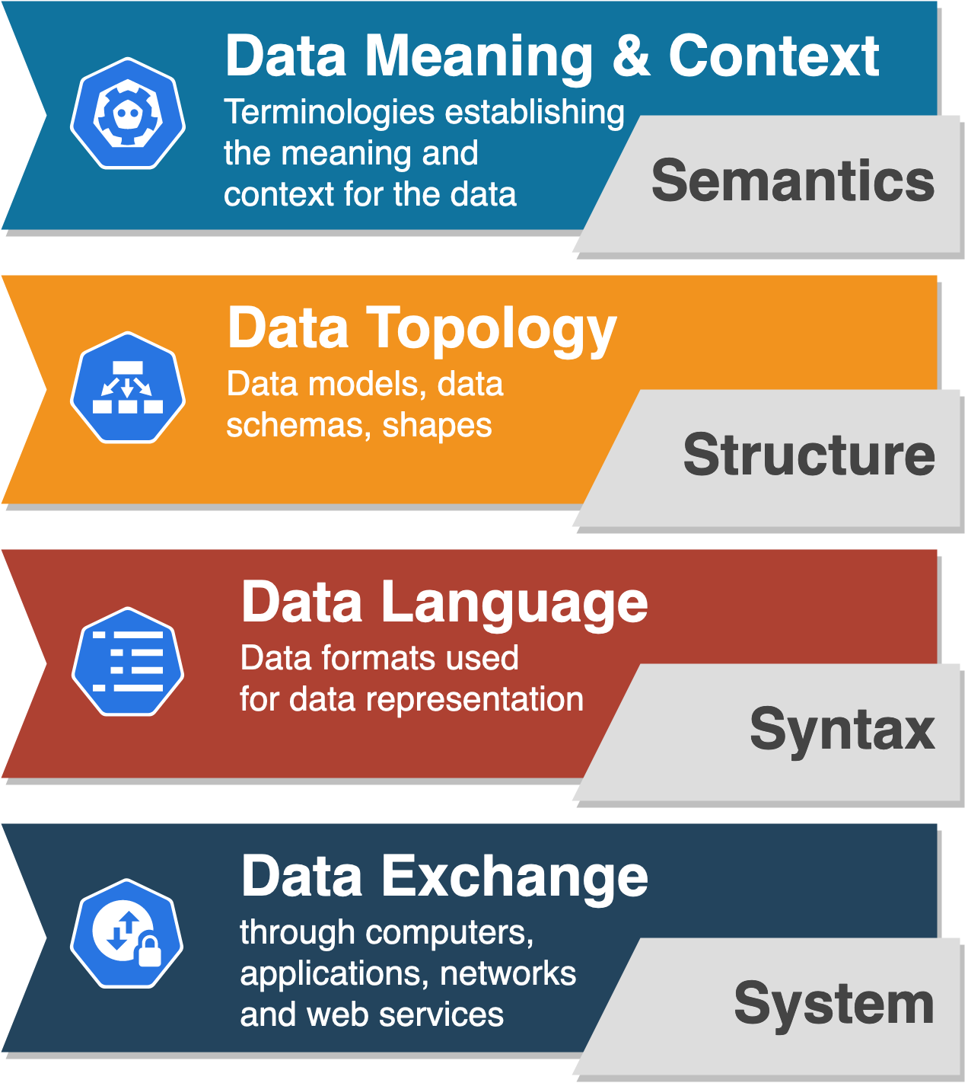
I1. (meta)data use a formal, accessible, shared, and broadly applicable language for knowledge representation.
I2. (meta)data use vocabularies that follow FAIR principles
I3. (meta)data include qualified references to other (meta)data
FAIR Guidelines: Interoperability
Common vocabularies
and mappings
WP2 & WP3 - work on vocabularies framework & ontologies
Common data schemas and validation processes
Use of NeXuS and its application definitions at facilities
Common data formats for different types of data and metadata
Use of HDF5 format and metadata catalogues
Common web services and Application Programming Interfaces (APIs) for data discovery, data access and data exchange
WP3 - implementation of common search API
Alejandra Gonzalez-Beltran

Slide 16
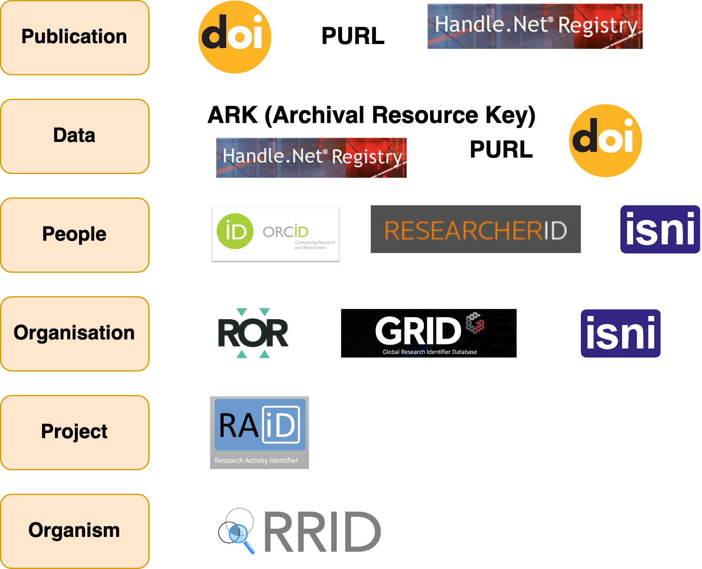





T2.4: FAIR Guidelines: Resource Identification
Persistent Identifier (PID)
Services
Purpose
Scope
Technology
Governance
Metadata
Cost
Uptake
What are the best choices for Facilities?
EOSC PID Policy
Instrument
Persistent Identification
of Instruments WG
A survey of PID services is available in:FREYA project. D3.1 Survey of Current
PID Services Landscape
https://www.project-freya.eu/en/deliverables/freya_d3-1.pdf
Sample
Software
RDA/FORCE11 Software Source Code Identification WG
Notes:
https://www.mitpressjournals.org/doi/full/10.1162/dint_a_00025
FREYA deliverable on identifiers
https://www.project-freya.eu/en/deliverables/freya_d3-1.pdf
https://www.slideshare.net/AustralianNationalDataService/unpacking-persistent-identifiers-for-research
https://www.softwareheritage.org/2020/07/09/intrinsic-vs-extrinsic-identifiers/

Slide 17
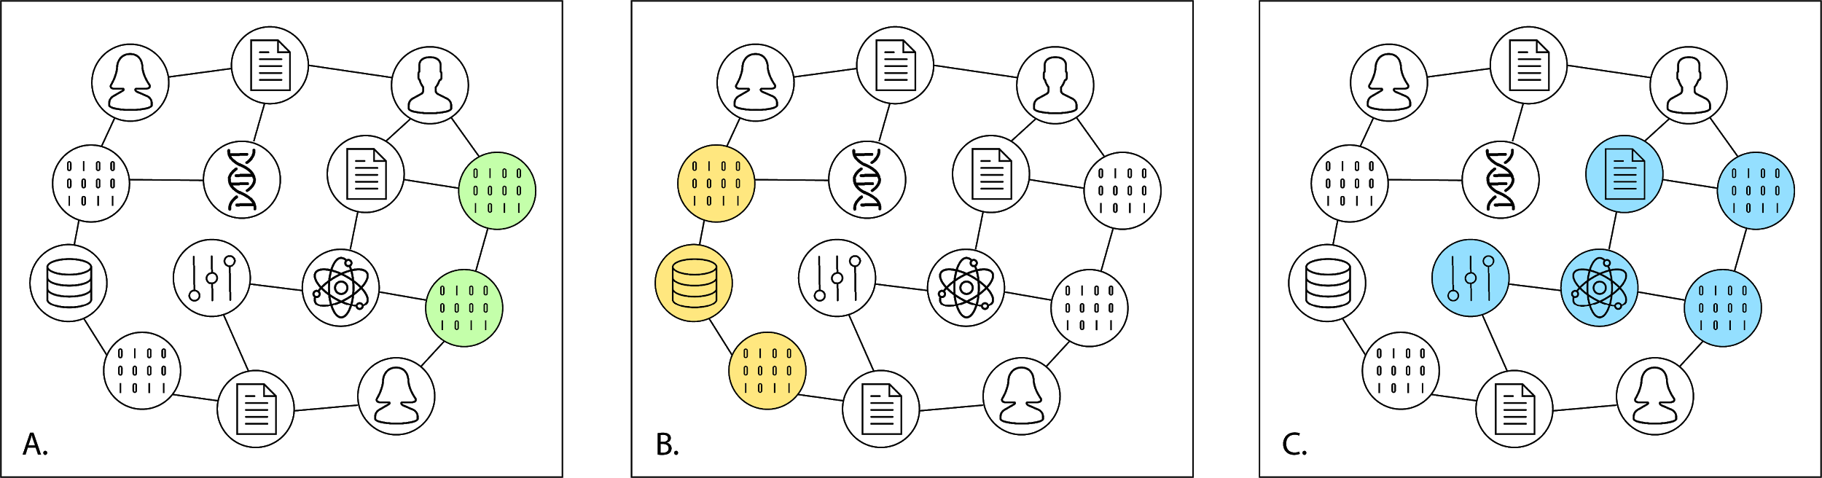
Resource Identification Graph
PIDs + metadata support linkages between resources
Software ←→ Software
Dataset ←→ Dataset
All digital objects associated with a dataset
Alejandra Gonzalez-Beltran
Introducing the PID Graph - March 28, 2019 by Martin Fenner and Amir Aryani https://doi.org/10.5438/jwvf-8a66
Notes:
Fig 1. A schematic representation of the PID graph with digital objects connected by PIDs, showing three use cases: A: Different versions of software code, B: Datasets hosted by a particular repository, C: All digital objects connected to a research object.

Slide 18
T2.2: Bringing FAIR to the Experiment
Data Policy applies at the facilities level
This needs to be made happen for each experiment
For each experiment
Data/Metadata to be collected, data storage, connections to derived data, software used
Sounds like Hard Work!!!
Data Management Planning
DMP for an experiment needs to be done in context:
The DMP for its instrument and technique
The community norms for the discipline
The DMP of the user’s institution and funder
The DMP should be active
Help steer the collection of metadata in the experiment
Work with for example an Electronic Notebook
Facility Data Policy
Funder Data Policy
University Data Policy
Discipline Norms
Instrument DMP
User DMP
Experiment DMP

Slide 19
FAIR Experiment: Data Management Planning
Plan the many aspects of data and metadata generation, preservation, and analysis at the outset
Information on data and data format
Types of data generated, Volumes of data, File formats
Collection processes
Software used, Analysed data
Quality control
Metadata content and format
Metadata items collected.
Metadata standards
How collected?
Policies for access, sharing, and re-use
Obligations from funders
Specific ethical/privacy and IPR issues
Data Publication
Digital Object Identifiers
Long-term storage and data management
Where is the data going to land?
Especially derived data
Costs
Pros: can really assist in the allocation of resources and generation of reusable data
Expected data volumes Identify analysis routes and workflows Identify and fix bottlenecks ahead of time
Cons: Users may be agnostic or less convinced.
Extra work for proposal writing, Additional bureaucracy for access, Poor past experiences with DMPs
DMPs need careful consideration and presentation in the P&N community

Slide 20
KPIs for WP2
WP2 Enabling FAIR data for EU PaN National Ris | Level of FAIR maturity of participating facilities (% - self-assessment)
 | # of facilities data policy explicitly mentioning FAIR
 | # of facilities data policy mentioning DMPs
 | # of facilities offering training related to FAIR data

Slide 21
Questions For Discussion
Making the WPs work more closely together
Key objectives
Harmonised Data Policy (guidelines and model policy)
Promoting standards (e.g. NEXUS, Metadata and Ontologies, PIDs)
DMPs (guidelines and template)
FAIR Metrics for Facilities
Advocacy for FAIR data
who should we influence and how?
Senior managers - LEAPS/LENS
Users
How can we maximise our impact ?
Take up
Challenges in implementing a FAIR Data Policy
Who is using DMPs and challenges in getting them used.
Working with standards bodies
Use cases and Success Stories
how do we gather use cases for added value ?

Slide 22
Thankyou
Brian Matthews
Brian.Matthews@stfc.ac.uk
https://expands.eu
Thanks to: Abigail McBirnie, Daniel Salvat, Alejandra Gonzalez-Beltran,
Andy Gotz, Jonathan Taylor, Silvie da Graca Ramos

